Slide 1
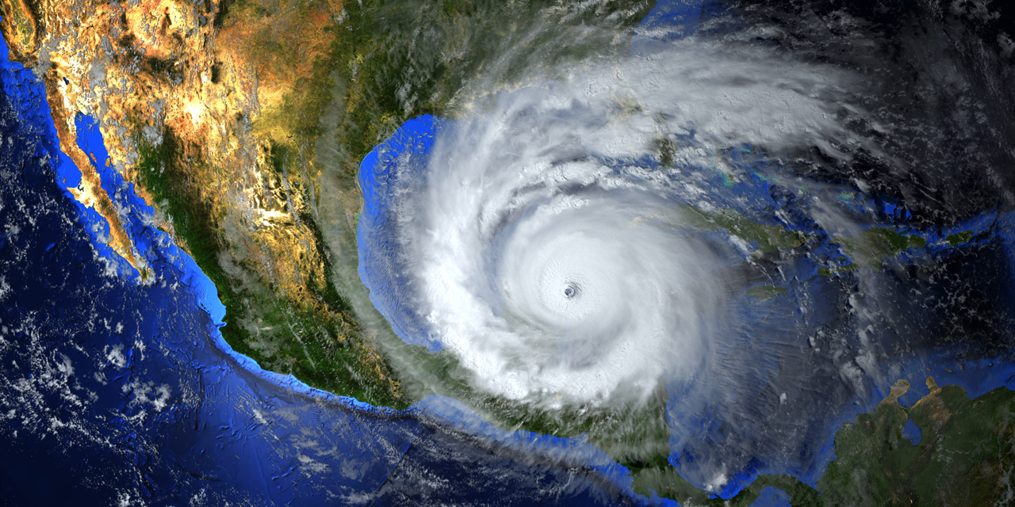
Notes:
Hello and welcome to my Article review

Slide 2


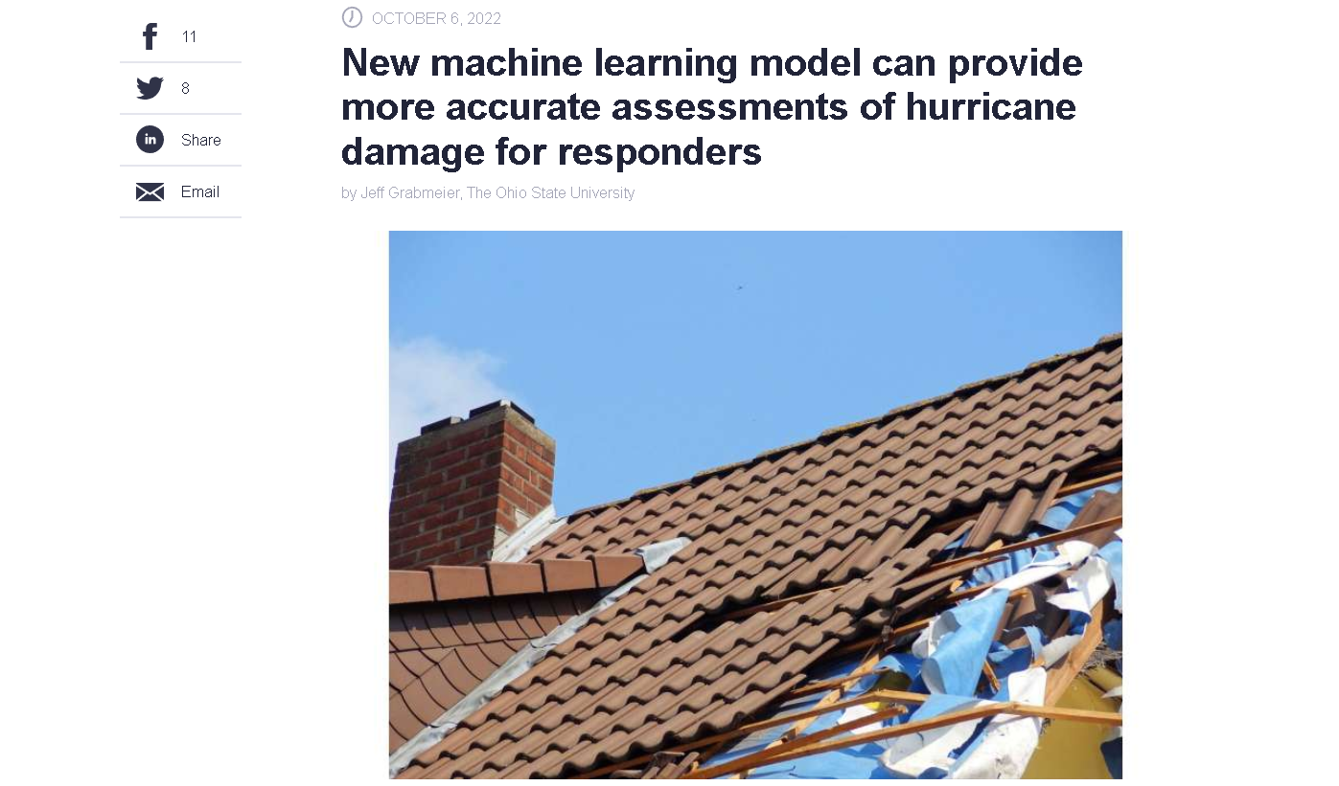
Notes:
Today I m speaking about an artical from
Jeff Grabmeier from the Ohio State University
on techexplore.com
the headline reads: New machine learning model can provide more accurate assessments of
hurricane damage for responders

Slide 3
What is the article about?
Notes:
What is the article about? the headline already reveals a lot
We speaking about→

Slide 4
What is the article about?
advantage of better prediction
data source
model
classification of damage
overall damage assessment
research study area

Slide 5
advantage of better prediction
Notes:
- a deep learning model can accurately classify how much damaged buildings sustained
- it help direct emergency management and first responders to where they should check first

Slide 6
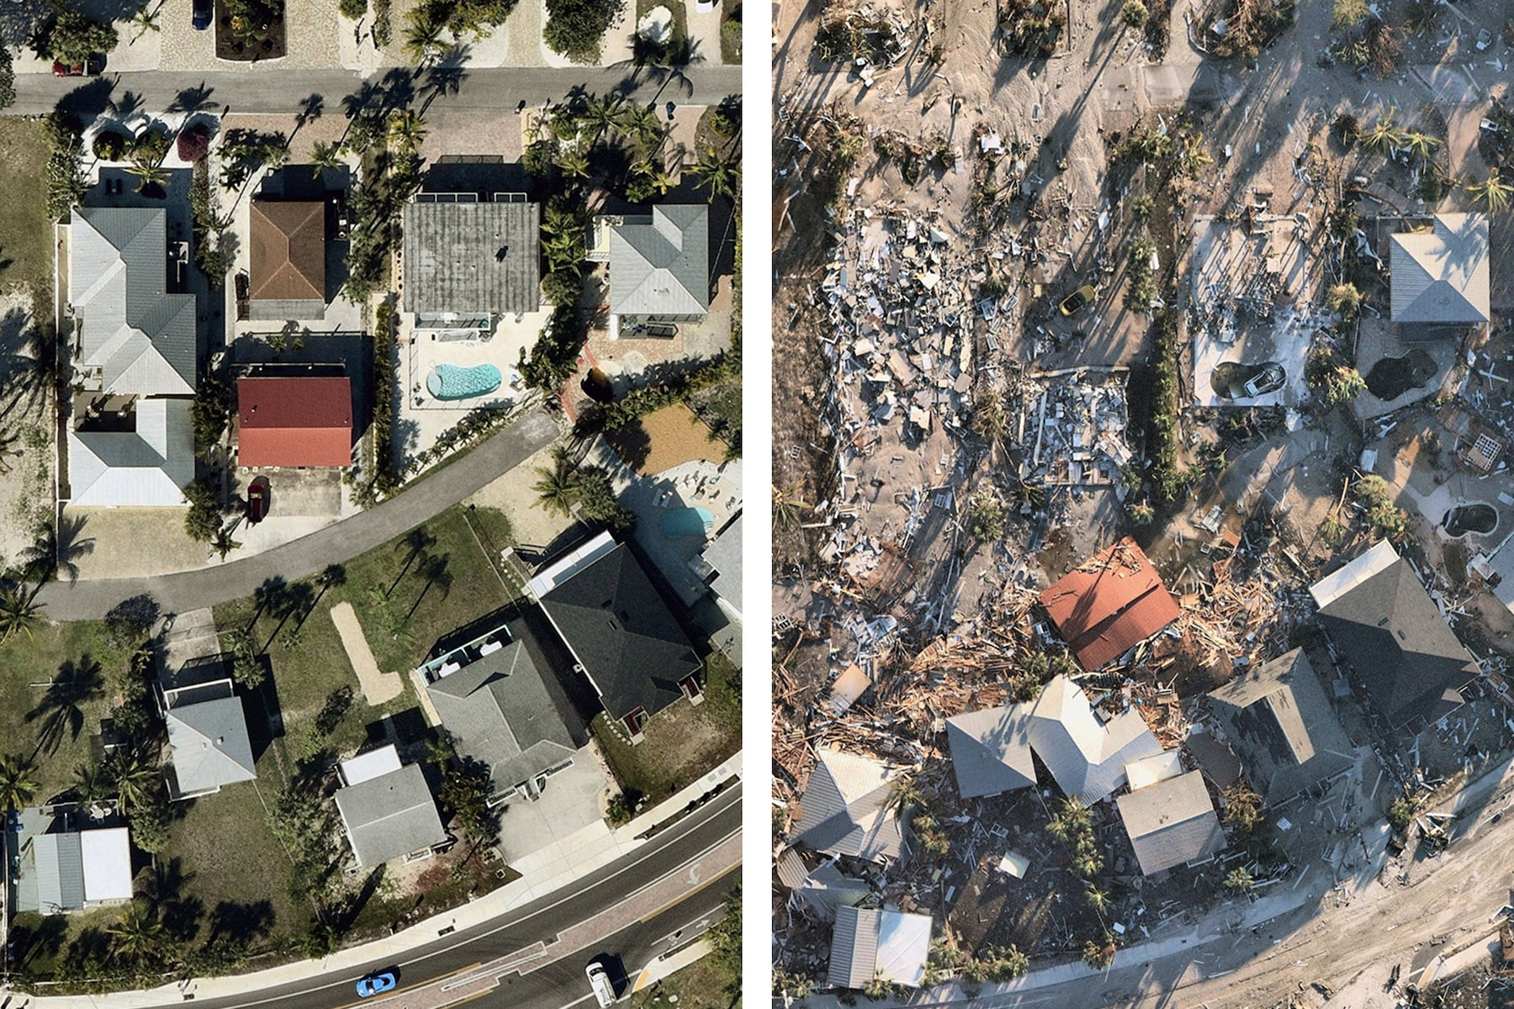

advantage of better prediction
Notes:
- a deep learning model can accurately classify how much damaged buildings sustained
- it help direct emergency management and first responders to where they should check first

Slide 7
data for predictions
Notes:
Where does the data for the predictions came from?

Slide 8
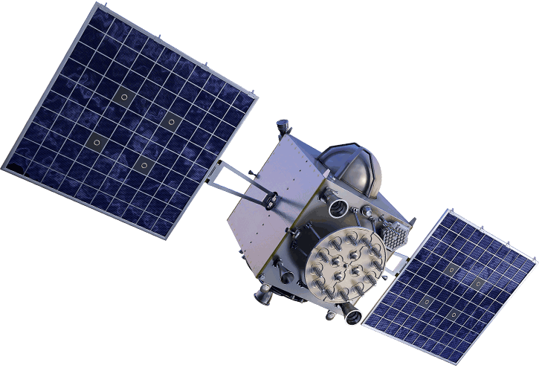
data for predictions
Notes:
“The model uses
remote sensing
from satellites
from pre-hurricane images
and then compare them with images
taken after the storm.”

Slide 9

convolutional neural network (CNN)
Notes:
The model used a convolutional neural network or CNN
the model first generate building footprints
from the pre-hurricane satellite imagery
and then classify the amount of damage after the storm“

Slide 10
convolutional neural network (CNN)
pre-hurricane satellite imagery
classify the buildings as undamaged
Building footprint (befor)

Slide 11
convolutional neural network (CNN)
pre-hurricane satellite imagery
post-hurricane satellite imagery
classify the amount of
damage after the storm
Compare pre- and post- Building footprint
Notes:
Post-event imagery was obtained on cloud-free days directly after the hurricane impact

Slide 12
classification of damage

Slide 13
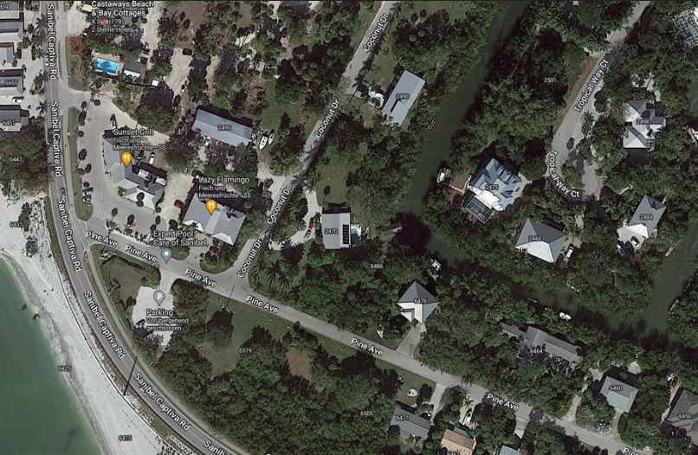
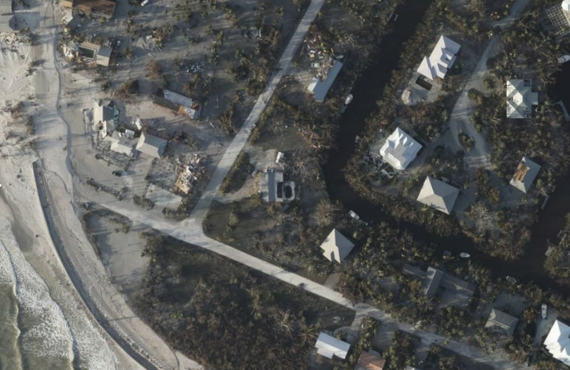
classification of damage
(CNN) : undamaged, minor damage, major damage or destroyed.”
old model (SVM): damaged and undamaged
Notes:
The model classified buildings as undamaged, minor damage, major damage or destroyed.
“The previous model could only distinguish between damaged and undamaged and was less accurate“

Slide 14

overall damage assessment
86.3% accuracy
Notes:
The researchers tested their new model on data from Hurricane Michael in 2018
The overall damage assessment was 86.3% accuracy

Slide 15
research study area

Slide 16
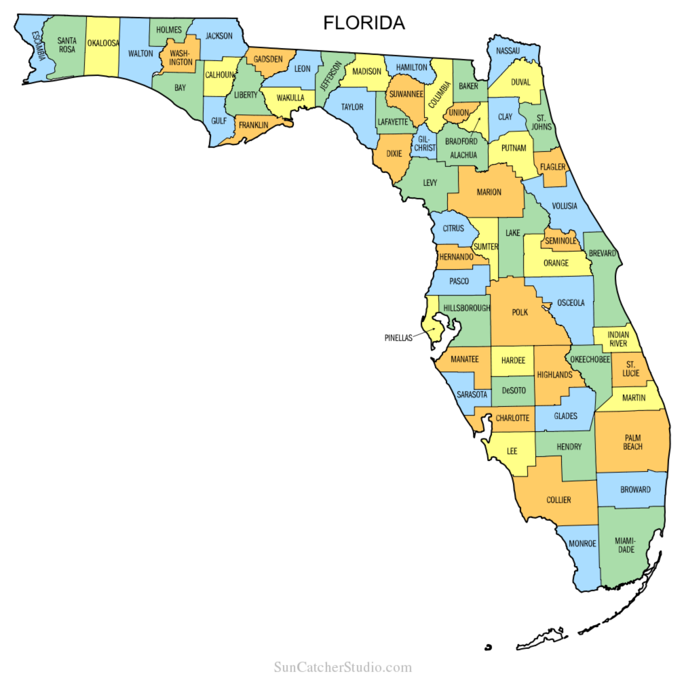
research study area
Panama City
Bay County
Calhoun
Gulf
Washington
Leon
Holmes
Notes:
The research study area included Bay County
Calhoun,
Gulf,
Washington,
Leon
Holmes
And Panama City
With is the major metropolitan area included in the study

Slide 17

research study area
Panama City
Bay County
Calhoun
Gulf
Washington
Leon
Holmes
22.686 buildings
Notes:
Within the dataset the study area included over 22.000 buildings

Slide 18
Summary

Slide 19
Summary
Provide key information for emergency responders
CNN classify the amount of damage
uses remote sensing from satellites
Notes:
The model provides key information for emergency responders
CNN classify the amount of damage after the storm
uses remote sensing from satellites

Slide 20
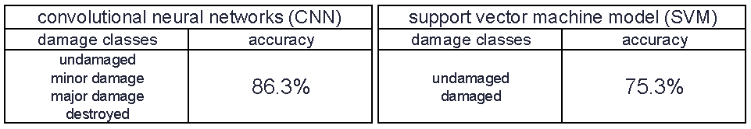
Summary
Provide key information for emergency responders
CNN classify the amount of damage
uses remote sensing from satellites
Notes:
the previous model could only distinguish between damaged and undamaged and was less accurate

Slide 21
Thanks, any questions?

Slide 22

food for thought:
think about the advantages and disadvantages
of the free availability
of worldwide daily updated satellite images

Slide 23
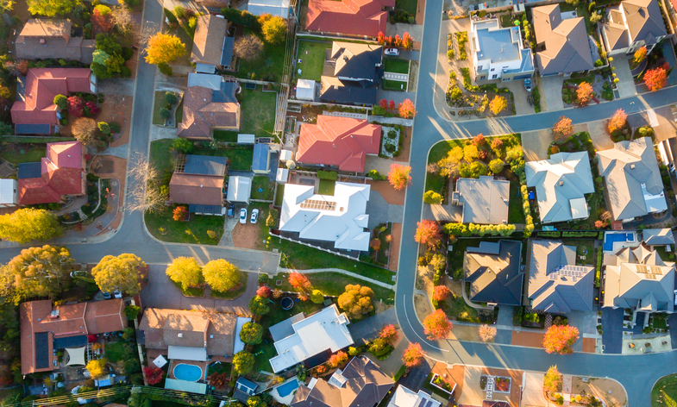
food for thought:
think about the advantages and disadvantages
of the free availability
of worldwide daily updated satellite images

Slide 24
food for thought:
think about the advantages and disadvantages
of the free availability
of worldwide daily updated satellite images
What could be the criteria
for restricting the data?

Slide 25
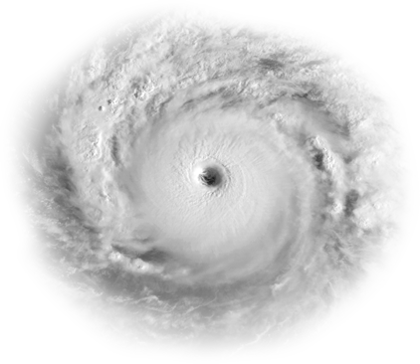
Process:
buy current satellite data
use CNN to create footprints of houses
hurricane takes place
buy current satellite data
use CNN to create footprints of houses
Compare old and new footprints with CNN
classify building damage with CNN
Sharing the information with the rescuers

Slide 26
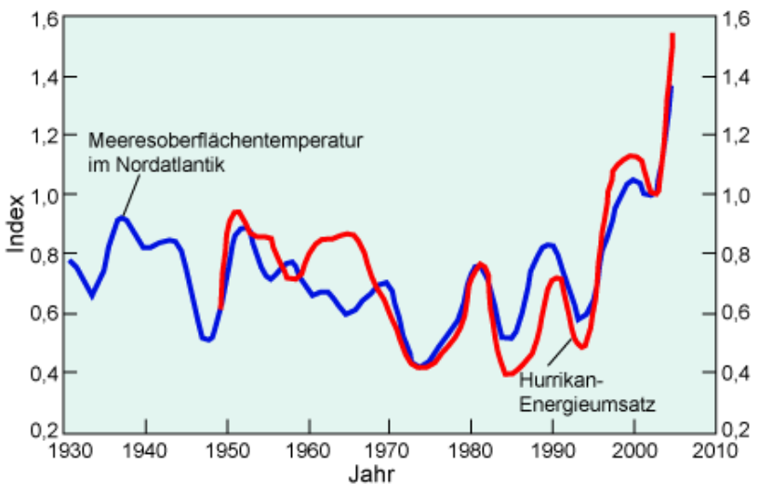
Index Hurricane Intensity (red) and Sea surface temperature (blue) 1930-2004:

Slide 27
New machine learning model can provide more accurate assessments of hurricane damage for responders
Article review:
Article by Jeff Grabmeier from the Ohio State University on techxplore.com
Notes:
Article review:
New machine learning model can provide more accurate assessments of
hurricane damage for responders
Article by Jeff Grabmeier from the Ohio State University on techxplore.com

Slide 28
The National Oceanic and Atmospheric Administration estimated the total damage to the U.S. economy from Hurricane Michael to equal $25 billion. Of that amount, $18.4 billion worth of damage occurred in Florida.
Notes:
The National Oceanic and Atmospheric Administration estimated the total damage to the U.S. economy from Hurricane Michael to equal $25 billion. Of that amount, $18.4 billion worth of damage occurred in Florida.

